Slide 1

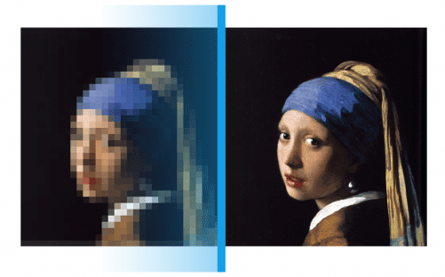
Super Resolution
Imaging
Tiago Rebelo

Slide 2
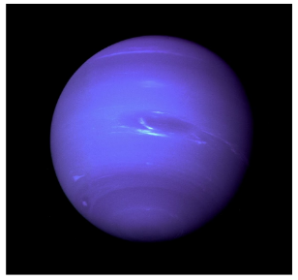
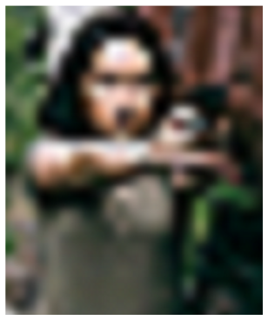
Image Quality
Affected by…
Suboptimal photographing conditions
Lens properties
Post-processing artifacts
Low resolution
Image is small
Object is far away
Neptune
(4.5 billion km away)
Security Camera
Notes:
Motion blur, poor lighting…

Slide 3


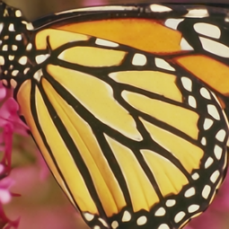
Super Resolution
Set of algorithms and techniques used to enhance, increase, and upsample the resolution of an input image
Classical techniques
Super Resolution techniques

Slide 4
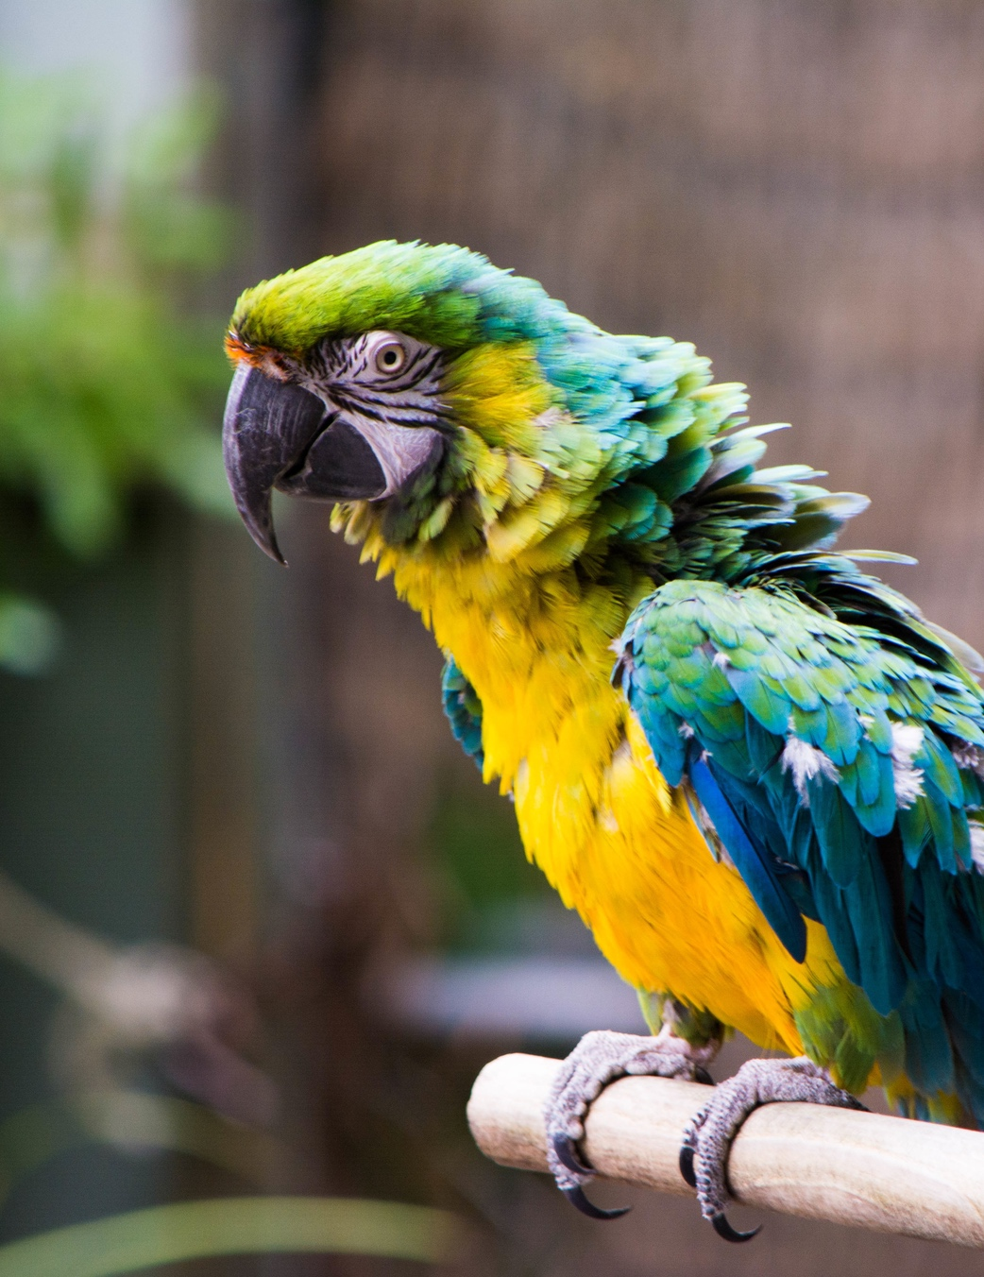



So why not use better cameras?
Compact lenses and sensors (poorer quality)
Costs (equipment & storage)
Many images already captured in Low Resolution
Notes:
So why don’t we just use better quality cameras, instead of going through the trouble of developing algorithms that can give us the same result anyway?
People want compact devices so there is a physical restriction regarding the size of lenses and sensors, which leads to a poorer quality
Better images depend on better equipment and storage which are more expensive (security cameras)
Lastly, many images with important information were already captured in low resolution. So super resolution is the only way.

Slide 5
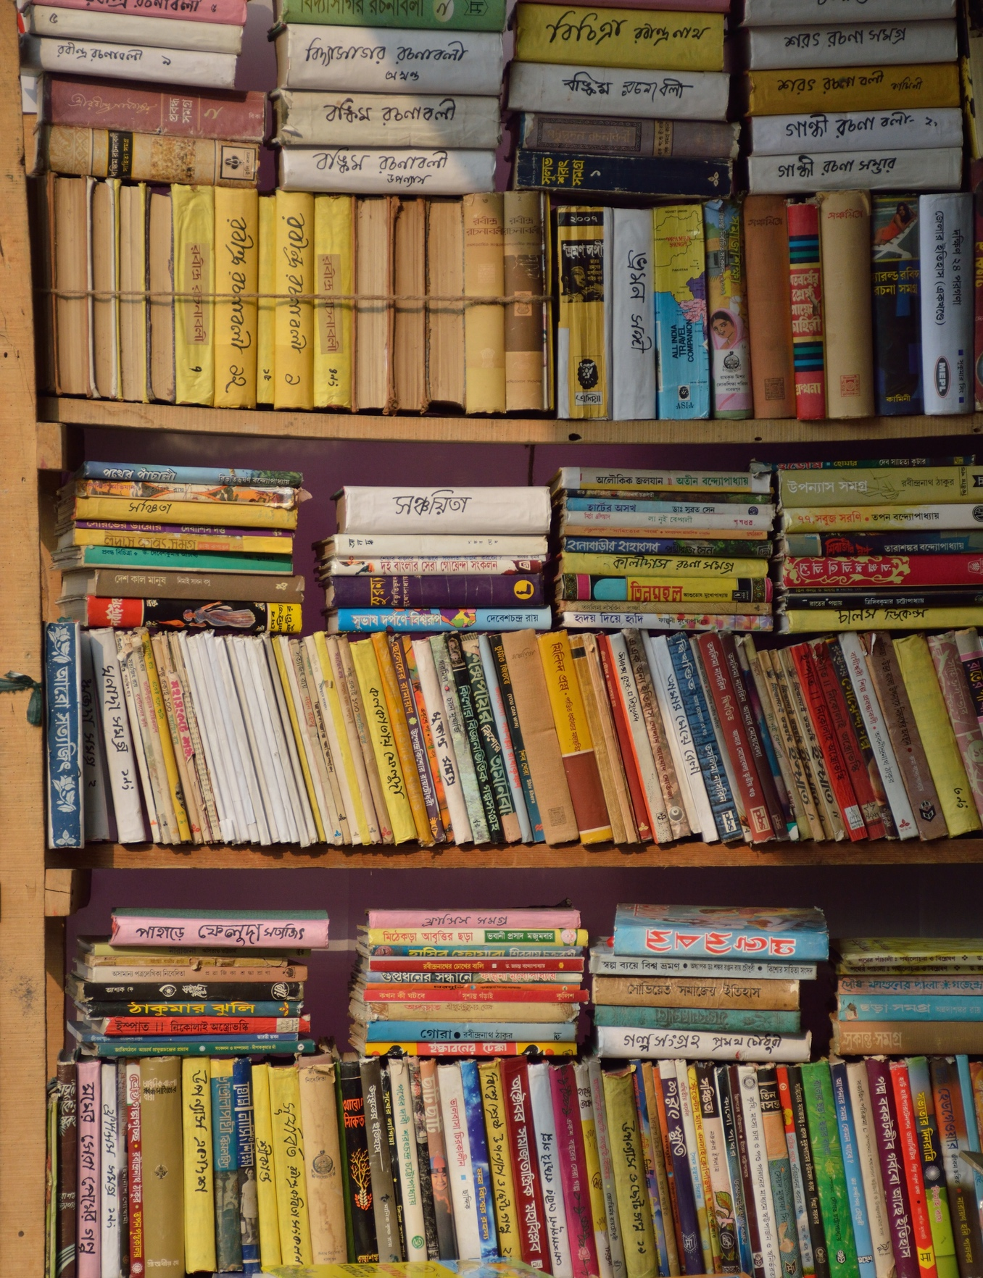



Picture Enhancing Tool
Efficient
Pictures are generated in seconds
Multipurpose
Generate, compare and download pictures in the same platform
User Friendly
Simple and intuitive interface
Free
For now…

Slide 6
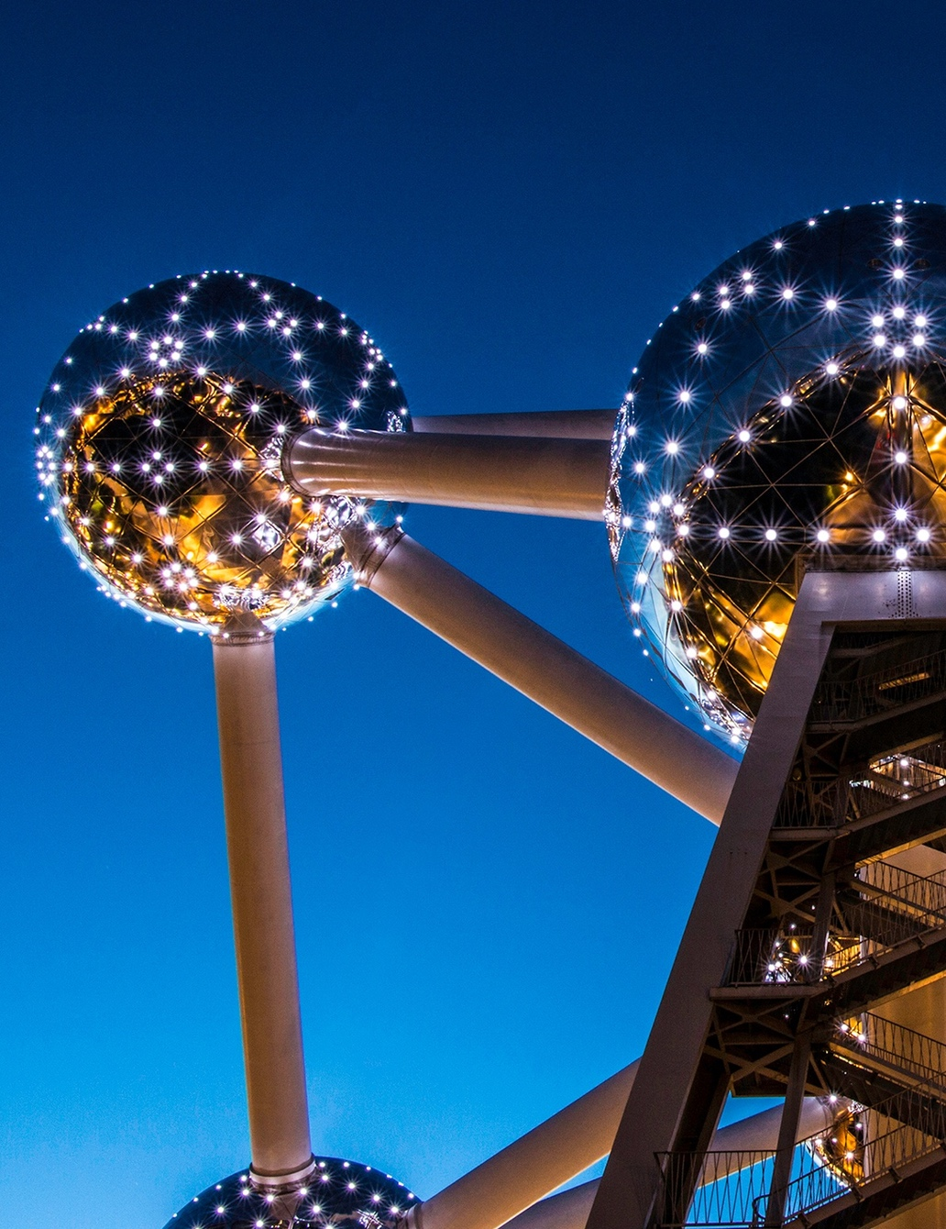
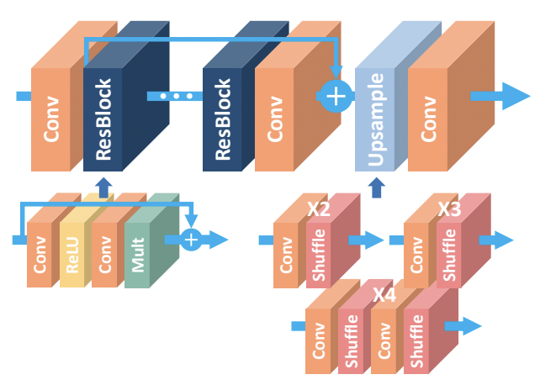
Action Plan
Choose Model - Enhanced Deep Residual Networks
Lim et al. (2017)
Notes:
Enhanced Deep Residual Networks

Slide 7
Action Plan
Choose Model
Image Database
- DIV2K Dataset
Notes:
Diverse 2K Dataset

Slide 8
Action Plan
Deep Learning
Choose Model
- 3 models trained
Image Database

Slide 9
Action Plan
Deep Learning
Choose Model
Image Database
Web App
(Streamlit)

Slide 10

Web App
PixelPro

Slide 11
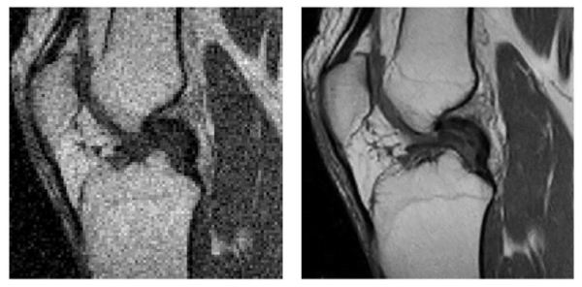
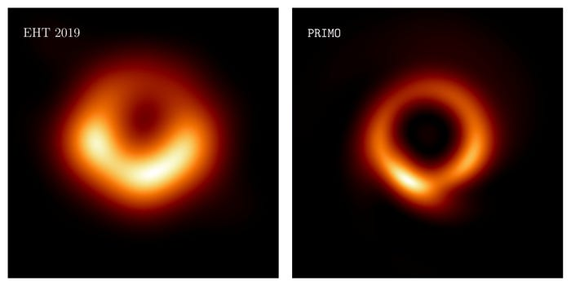
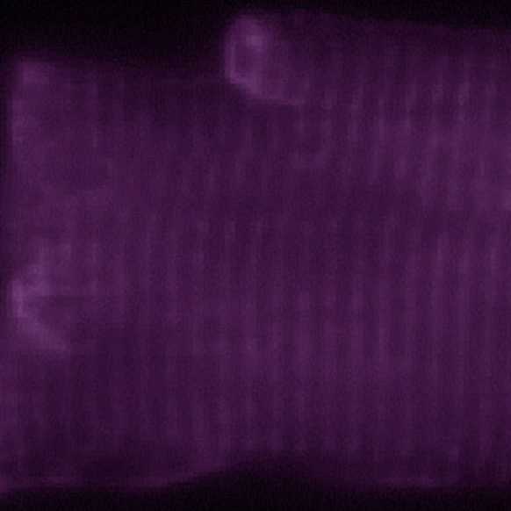
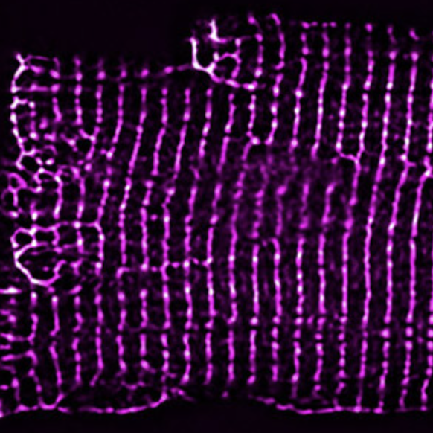
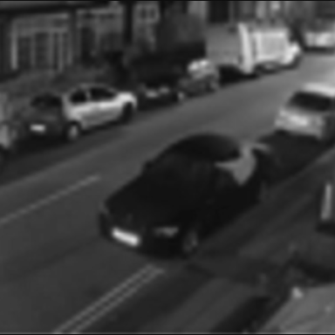
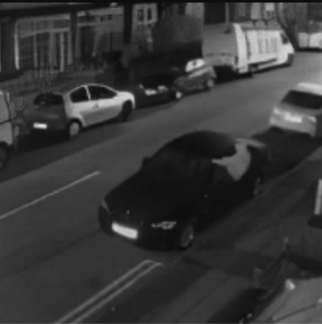
Applications
Medical Imaging
Astronomical Imaging
Microscopy Imaging
Surveillance Imaging
…

Slide 12
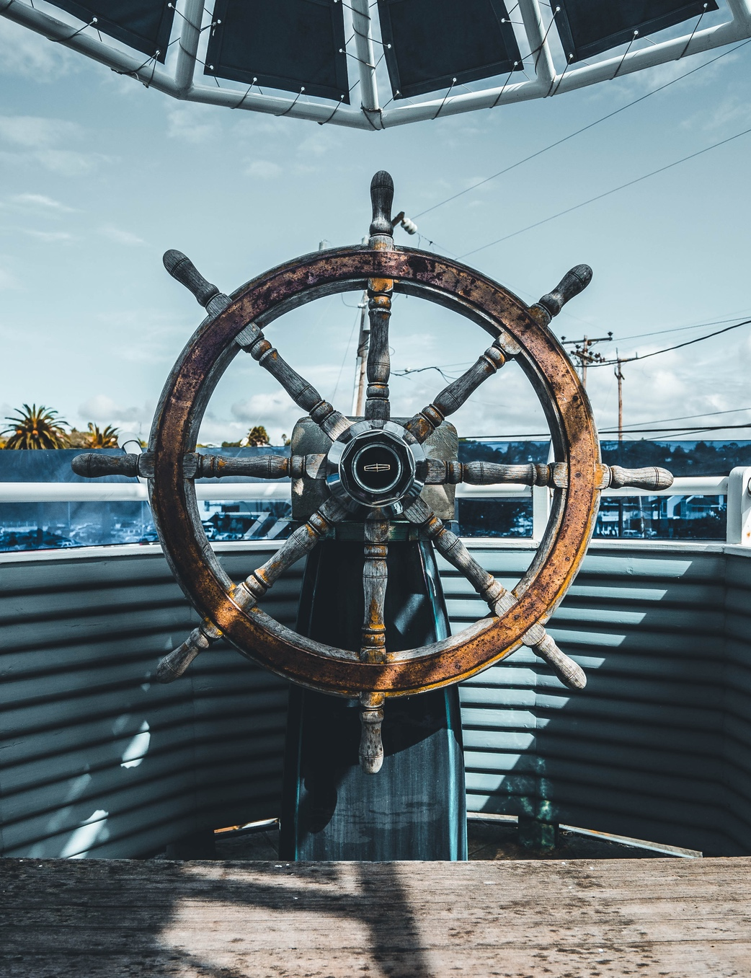


Future Improvements
Include other types of degradation in the training data
e.g. noise model, blur kernel estimation…
Include more scaling factors
Compare scaling vs. scaling
Notes:
We used bicubic interpolation

Slide 13
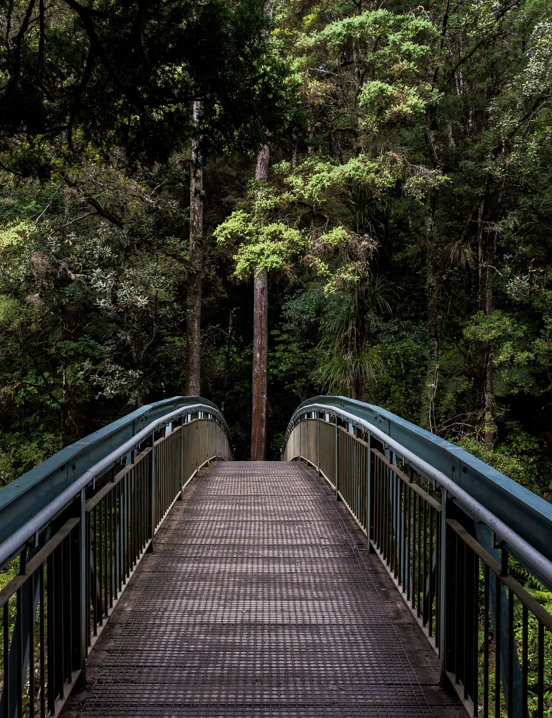


THANK YOU!
Questions?
Tiago Rebelo
www.linkedin.com/in/tiagorebelo22
github.com/tiagorebelo22
Notes:
We used bicubic interpolation

